Slide 1
Who is who?
Подготовила Мышелова О. А.
МОАУ «СОШ №25 Г.ОРСКА»

Slide 2
“The Flight of Youth” by Richard Henry Stoddard.
There are gains for all our losses,
There are balms for all our pain:
But when youth, the dream, departs,
It takes something from our hearts,
And it never comes again.
We are stronger, and are better,
Under manhood's sterner reign:
Still we feel that something sweet
Followed youth, with flying feet,
And will never come again.
Something beautiful is vanished,
And we sigh for it in vain:
We behold it everywhere,
On the earth, and in the air,
But it never comes again.

Slide 3

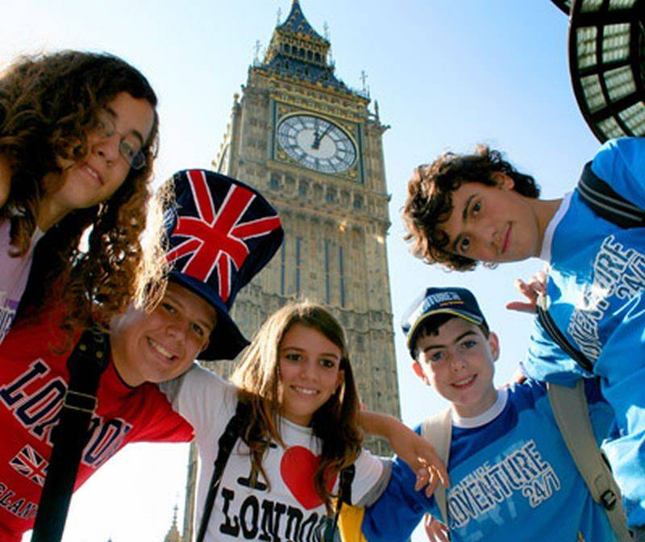

Slide 4
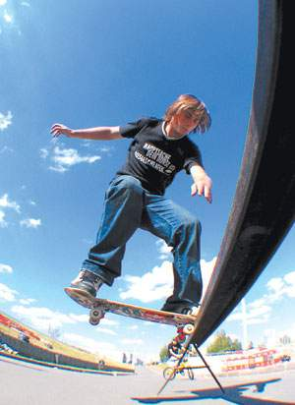
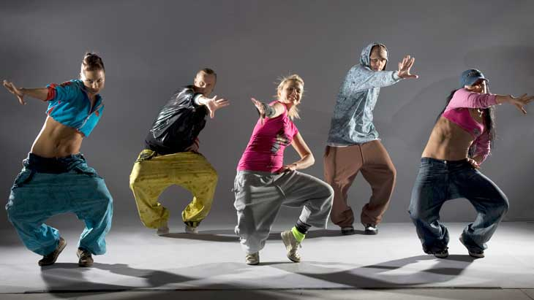
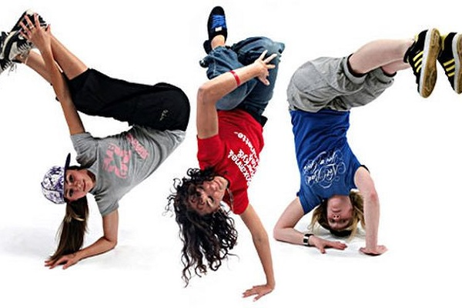

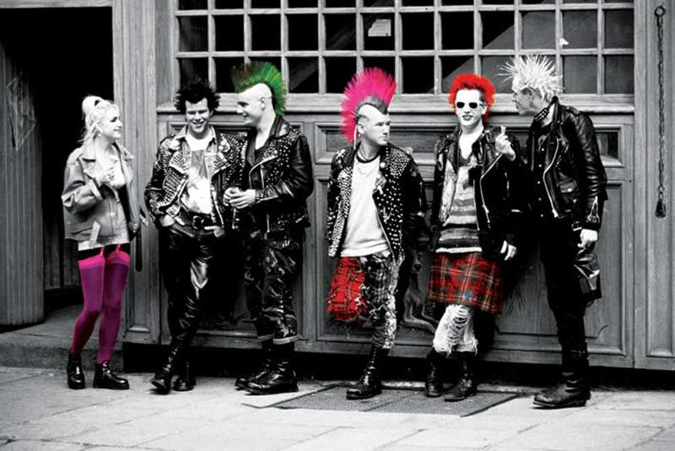


Slide 5
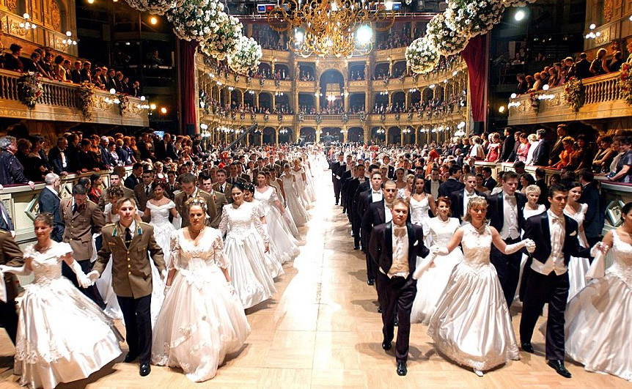

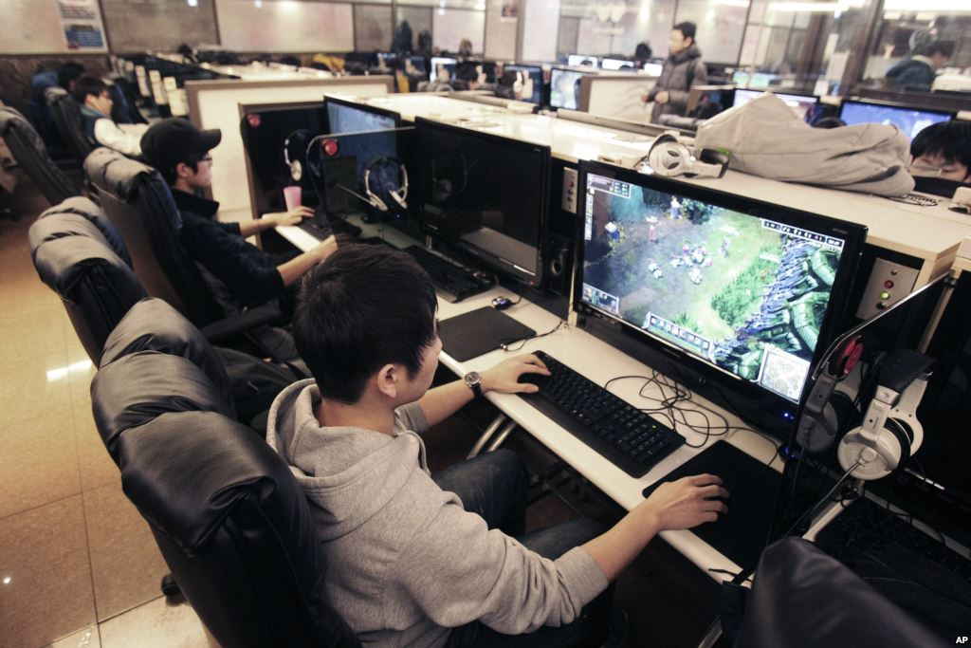
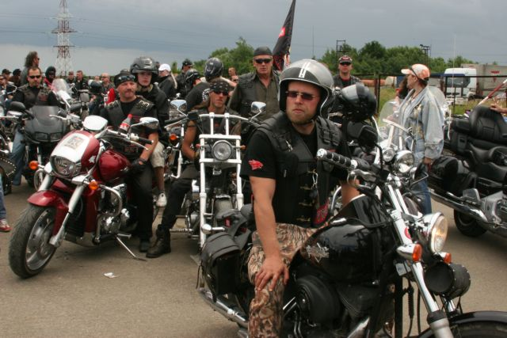

Slide 6
The word “youth”
1.[in singular] The period between childhood and adult age:
‘he had been a keen sportsman in his youth’
1.1[mass noun] The qualities of vigor, freshness, or immaturity as associated with being young:
‘she imagined her youth and beauty fading’
vigor – сила, энергия
Immaturity – незрелость
2. A young man:
‘he was attacked by a gang of youths’
2.1.[treated as singular or plural] Young people considered as a group:
‘black youth has experienced high levels of racial discrimination’
[as modifier] ‘youth culture’

Slide 7
Positive youth qualities | Negative youth qualities
energy | aggressiveness
attractiveness | self-absorbed
activeness | selfishness
self-improvement | inconsistency
curiosity | self-importance
creativeness | inexperience
mobility | misunderstanding

Slide 8
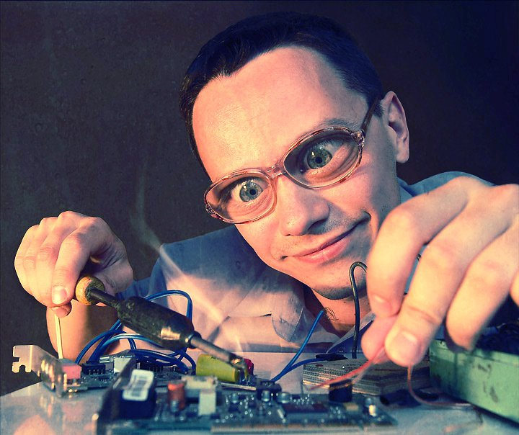
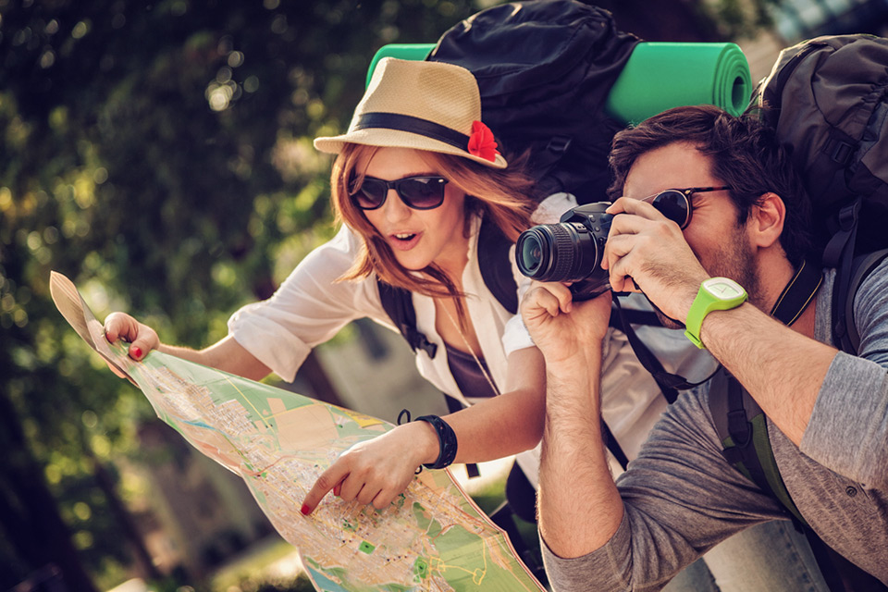
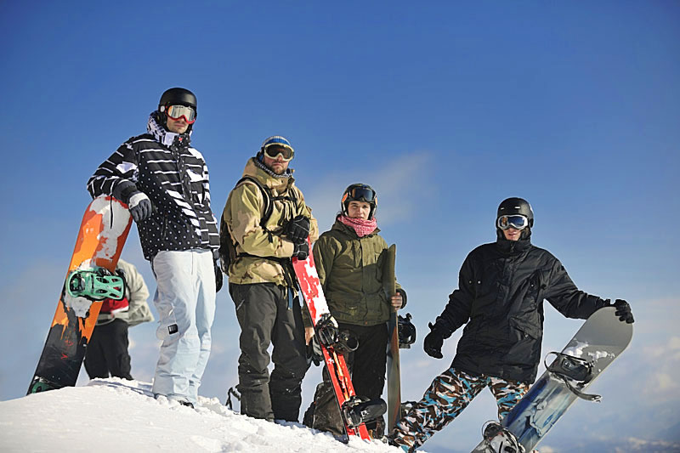
Task 3. These are photos from your photo album. Choose one photo to describe to your friend. You will have to start speaking in 1.5 minutes and will speak for not more than 2 minutes (12–15 sentences). In your talk remember to speak about:
• where and when the photo was taken
• what/who is in the photo • what is happening
• why you keep the photo in your album
• why you decided to show the picture to your friend
You have to talk continuously, starting with: “I’ve chosen photo number …”

Slide 9

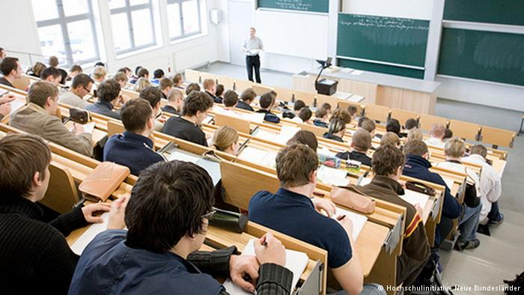
Task 4. Study the two photographs. In 1.5 minutes be ready to compare and contrast the photographs: give a brief description of the photos (action, location)
• say what the pictures have in common
• say in what way the pictures are different
• say which of the ways of reading a book presented in the pictures you’d prefer
• explain why
You will speak for not more than 2 minutes (12–15 sentences). You have to talk continuously.

Slide 10
Home task
Basic level: Write a letter to your friend by theme «The youth’s problems in my country»
Advanced level: Write an essay «Some people say that modern young people are carefree»

Slide 11
Thank you
for the lesson.

